Slide 1
Learning from Todays Session
This session will explain How RDBMS will work and user can interact with different parts of database.
This session brings an effective presentation to learn various ways to use database through different commands.
After this session students will be able to create their own data base along with manipulation operations.

Slide 2
Contents
Learning from this session
About Database languages
What are different database languages
Types of Database Languages
DDL
DML
DCL
TCL
Various Database Language platforms

Slide 3
Contents
SQL
XQUERY
OQL
SQL/XML
GraphQL
LINKQ
SQLProcess
SQL Rules
Conclusion

Slide 4

About Database Languages
Databases serve an important function for many individuals and companies, providing a practical way to organize and store information on a computer. In programming, developers use database languages to maintain and monitor an electronic database and its management system. These languages perform a variety of critical tasks that help a database management system function correctly.

Slide 5
What are database languages?
Database languages, also known as query languages or data query languages, are a classification of programming languages that developers use to define and access databases, which are collections of organized data that users can access electronically. These languages allow users to complete tasks such as controlling access to data, defining and updating data and searching for information within the database management system (DBMS).

Slide 6
What are database languages? Cont..
A DBMS provides necessary database languages that allow users to express database updates and queries, which are requests for data. There are different examples of database languages available, including SQL, which is the standard programming language for many databases. Database languages comprise four sublanguages that serve different functions to execute tasks.

Slide 7
Database Language
A DBMS has appropriate languages and interfaces to express database queries and updates.
Database languages can be used to read, store and update the data in the database.

Slide 8
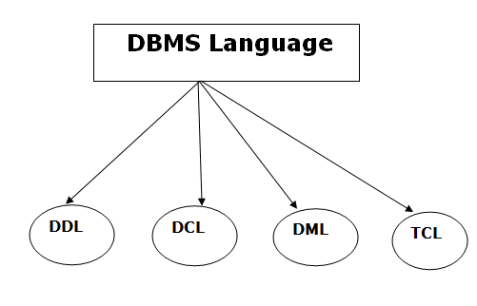
Types of Database Language

Slide 9
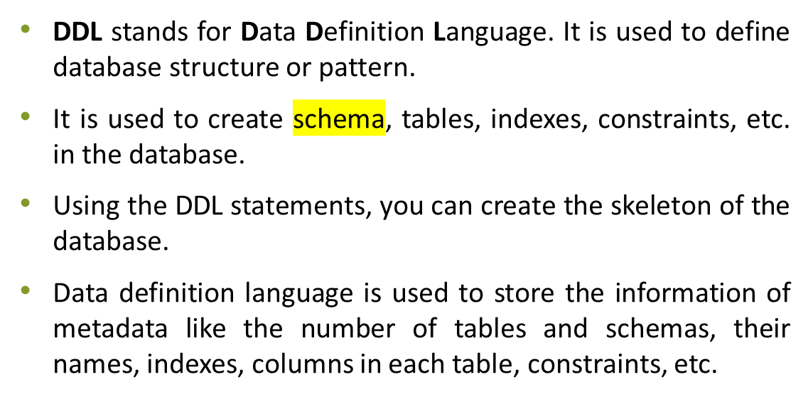
Data Definition Language

Slide 10
DDL
Here are some tasks that come under DDL:
Create: It is used to create objects in the database.
Alter: It is used to alter the structure of the database.
Drop: It is used to delete objects from the database.
Truncate: It is used to remove all records from a table.
Rename: It is used to rename an object.
Comment: It is used to comment on the data dictionary.
These commands are used to update the database schema that's why they come under Data definition language.

Slide 11
Data Manipulation Language
DML stands for Data Manipulation Language. It is used for accessing and manipulating data in a database. It handles user requests.
Here are some tasks that come under DML:

Slide 12
DML
Select: It is used to retrieve data from a database.
Insert: It is used to insert data into a table.
Update: It is used to update existing data within a table.
Delete: It is used to delete all records from a table.
Merge: It performs UPSERT operation, i.e., insert or update operations.
Call: It is used to call a structured query language or a Java subprogram.
Explain Plan: It has the parameter of explaining data.
Lock Table: It controls concurrency.

Slide 13
Data Control Language
DCL stands for Data Control Language. It is used to retrieve the stored or saved data.
The DCL execution is transactional. It also has rollback parameters.
(But in Oracle database, the execution of data control language does not have the feature of rolling back.)
Here are some tasks that come under DCL:
Grant: It is used to give user access privileges to a database.
Revoke: It is used to take back permissions from the user.
There are the following operations which have the authorization of Revoke:
CONNECT, INSERT, USAGE, EXECUTE, DELETE, UPDATE and SELECT.

Slide 14
Transaction Control Language
TCL is used to run the changes made by the DML statement. TCL can be grouped into a logical transaction.
Here are some tasks that come under TCL:
Commit: It is used to save the transaction on the database.
Rollback: It is used to restore the database to original since the last Commit.

Slide 15
Various database languages Platforms
SQL
SQL, which stands for Structured Query Language, is one of the most well-known and longest-running database languages. It features both data definition and data manipulation languages and allows you to write queries in a database. Specifically, SQL provides a way for you to extract and manage data in a relational database management system. This type of DBMS organizes data into groups called relations. Because most relational databases use SQL as the database language, many jobs in the IT industry may require their employees to have an understanding of it.

Slide 16
XQuery
XQuery is a database language that allows you to extract and manipulate data in XML formats, which is a way to share data on the internet. You can use XQuery to access and retrieve any data source in an XML format. With XQuery, you can generate reports on data within an XML database, search text documents on the web for data and extract data for use online.

Slide 17
OQL
OQL, which stands for Object Query Language, is the standard language for object-oriented databases, which represent data as variables, functions or data structures. These databases are popular with companies that want to store large amounts of complex data. Much like SQL does in relational databases, OQL gives you the option to perform queries and retrieve data in object databases.

Slide 18
SQL/XML
The SQL/XML language is a combination of SQL and XQuery that supports the manipulation and storage of XML data in a database that works with SQL. It enables applications to perform SQL statements on XML data and vice versa. It's helpful when you want to extract content from an XML document or if you want to ensure compatibility with future optimizations or systems that may only support XML.

Slide 19
GraphQL
GraphQL is an open-source language that works with APIs, which are interfaces that allow users to interact with data. It provides a way to define the structure of data and how the system returns information in order to prevent the release of excessive amounts of data. It's helpful when you want to extract data from multiple APIs, aggregate data from different sources or specify the data efficiently.

Slide 20
LINQ
LINQ, or Language Integrated Query, is a language that extracts and processes data from XML documents, relational databases and other third-party sources. With LINQ, you can access data through various sources without having to use a separate database language for each one. This ensures consistency among queries for objects, relational databases and XML, allowing you to filter, order and group operations.

Slide 21
SQL
SQL stands for Structured Query Language. It is used for storing and managing data in relational database management system (RDMS).
It is a standard language for Relational Database System. It enables a user to create, read, update and delete relational databases and tables.
All the RDBMS like MySQL, Informix, Oracle, MS Access and SQL Server use SQL as their standard database language.
SQL allows users to query the database in a number of ways, using English-like statements.

Slide 22
SQL :Rules
SQL follows the following rules:
Structure query language is not case sensitive. Generally, keywords of SQL are written in uppercase.
Statements of SQL are dependent on text lines. We can use a single SQL statement on one or multiple text line.
Using the SQL statements, you can perform most of the actions in a database.
SQL depends on tuple relational calculus and relational algebra.

Slide 23
SQL process
When an SQL command is executing for any RDBMS, then the system figure out the best way to carry out the request and the SQL engine determines that how to interpret the task.
In the process, various components are included. These components can be optimization Engine, Query engine, Query dispatcher, classic, etc.
All the non-SQL queries are handled by the classic query engine, but SQL query engine won't handle logical files.

Slide 24
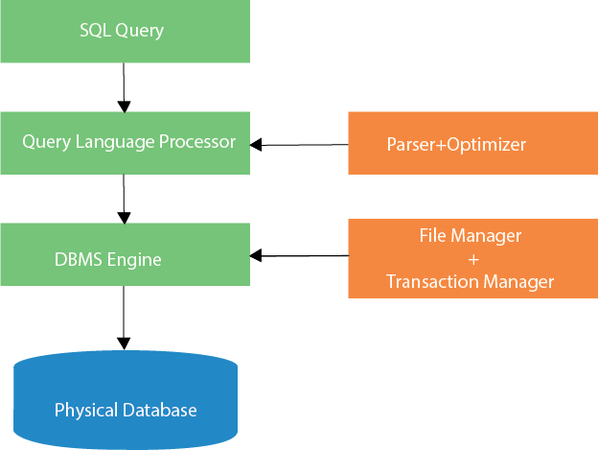
SQL Process

Slide 25








Conclusion
This session describes the SQL and other database languages which helps students to learn about the various categories and commands used for inserting, updating and deleting data.

Slide 26
Question Please ?

